Slide 1

Employee Data Analysis using Excel
STUDENT NAME: SOLOMON MANOVA.P
REGISTER NO: FAB5C6039F810B4A5E94AF11448FD6A5
DEPARTMENT: BCOM(GENERAL)
COLLEGE: DON BOSCO ARTS & SCIENCE COLLEGE, CHENNAI
Notes:
null

Slide 2

PROJECT TITLE
Current Employee Rating Analysis using Excel

Slide 3



AGENDA
Problem Statement
Project Overview
End Users
Our Solution and Proposition
Dataset Description
Modelling Approach
Results and Discussion
Conclusion
3/21/2024 Annual Review

Slide 4

PROBLEM STATEMENT
Analyzing current employee ratings is essential for tracking performance trends and ensuring alignment with company objectives. It helps identify areas where additional training or support is needed to enhance skills. Moreover, regular analysis can improve employee engagement by addressing potential issues early, leading to a more motivated and productive workforce.

Slide 5

PROJECT OVERVIEW
Total Employees: The dataset includes 1,038 employees across various business units.
Average Ratings: The overall average employee rating across all units is approximately 2.95.
Top and Bottom Units:
Highest Average Rating: SVG (3.03)
Lowest Average Rating: TNS (2.79)

Slide 6

WHO ARE THE END USERS?
1. Human Resources (HR).
2. Management and Leadership.
3. Employee Development Teams.
4. Business Unit Heads.
5. Analytics and Strategy Teams.
6. Compensation and Benefits Teams.
7. Employee Engagement Committees.
8. Talent Acquisition Teams.
9. Legal and Compliance Departments.
10. Board of Directors or Executive Committee.
11. Financial Planning and Analysis (FP&A) Teams.
12. IT and Data Analytics Teams.
13. Firms and Industry.

Slide 7

OUR SOLUTION AND ITS VALUE PROPOSITION
Filtering: To focus on targeted analysis, remove error reduction,customization etc.
Conditional formatting: To visual insights,quick analysis,error detection,focus on priorities.
Pivot Table & Graphs: Data Summarization,Filtering and Sorting,CrossTabulation,Flexibility,Data Visualization,Interactive Analysis,Multiple Chart Types,Enhanced Communication.

Slide 8
Dataset Description
Employee data set- Kaggle
Features:
Employment ID
Gender- male,female
Performance
Busniess Unit
Name
Rating
Graphs
Chart

Slide 9

THE "WOW" IN OUR SOLUTION
Features and Functionality in my Dataset:
1. Data Summarization
2. Aggregation
3. Category Breakdown
4. Rating Distribution
3/21/2024 Annual Review

Slide 10
MODELLING
Descriptive Analytics
Predictive Modeling
Regression Analysis
Clustering
Classification
Time Series Analysis
Decision Trees

Slide 11
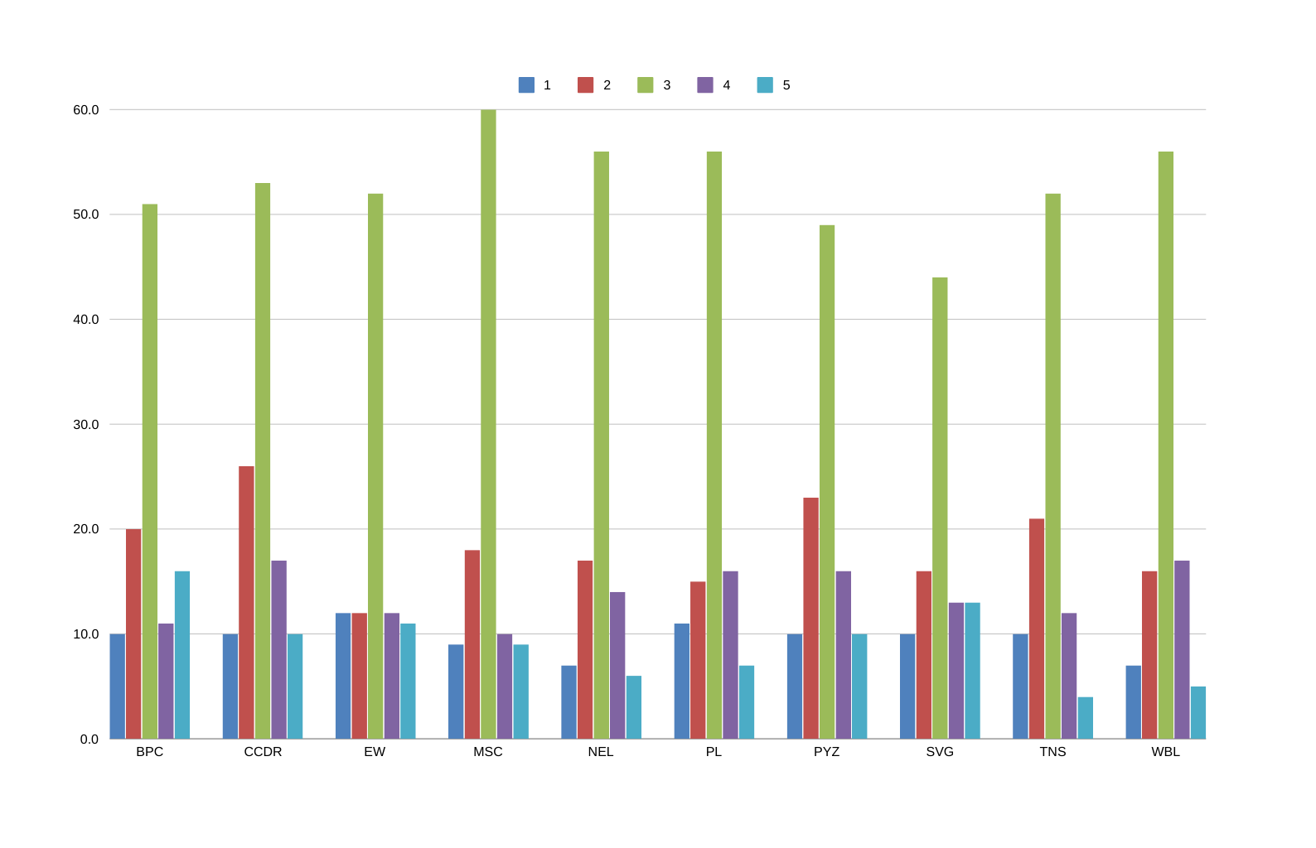
RESULTS

Slide 12
conclusion
The current employee rating analysis reveals variability in ratings across different business units, suggesting differences in performance or evaluation standards. However, the dataset's inconsistencies, including missing values and structural issues, may impact the reliability of these insights. To draw more accurate conclusions, the data requires cleaning and proper formatting. Once addressed, a more detailed analysis could pinpoint specific areas of strength or concern, guiding potential performance improvements or targeted interventions within the organization.

